Slide 1
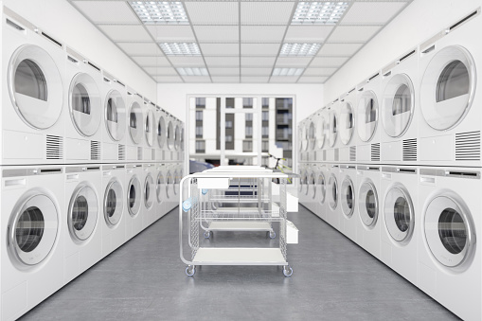

Available Machines in Laundry Room (Monte Carlo Simulation)
Team: Diyan Zhang, Hao Jia
IS597PR Fall 2021

Slide 2
Background & Purpose
Background:
Most of the apartments managed by the university still only have a communal laundry room in Champaign;
It should be noted that Orchard Downs is a community that primarily provided for graduate students and their families.
The room types contain 2B2B and 1B1B. About 40% of 2B2B tenants are families (more than 3 people), 20% are one person, and 40% are two people. For 1B1B, 50% are two people living, and 50% are living alone.
Purpose: calculate the average waiting period for students to save their time

Slide 3
01
Design Assumptions
The laundry room is only available to tenants in the Orchard Downs community. And the laundry room can be used 24 hours.
People usually start washing clothes from 8 am to 10 pm, and they are more likely to start washing clothes at 6:00 PM-9:00 PM. And people prefer to do laundry on weekends.
Every time washing clothes, they need to use both washing machines and dryers.
If the washing frequency is once a week:
Each family (more than 3 people) and a unit with 2 people must use 3 washing machines and 2 dryers each time.
A tenant living alone uses 2 washing machines and 1 dryer at a time.
If the washing frequency is twice a week or more:
Each family (more than 3 people) and a unit with 2 people use 2 washing machines and 1 dryer each time.
A tenant living alone uses 1 washing machine and 1 dryer at a time.

Slide 4
02
Variables
The interval between the user putting clothes from the washing machine to the dryer
The number of dryers and washing machines
The washing frequency of each unit
Number of residents planning to do laundry this week
Each run time of the washing machine and dryer

Slide 5
03
Hypotheses
No more than 80% of the time in a week, people go to the laundry to complete the washing and drying work within 2 hours
If 20% of residents reduce their washing frequency per week, the average queue time will be reduced

Slide 6
04
Workflow
Input
[num_WashMachine, num_Dryer, num_resident, time_interval, washTime, dryTime, frequency]
Update_method:
[the result of “total_num_of_eachday”]
From 8 am to 10 pm – total 14*60 mins
- random.choices
Randomly assign laundry date;
Assumption
Specify the number of machines that the unit needs to use (frequency)
# washing process
(Suppose a user needs to use n washing machines. The user uses the current available machines instead of using the current washing machine n times.)
## After washing all clothes, the user will proceed to the drying step ##
- random.choices
Randomly set interval time;
# drying process
(Similar to the above, the user uses the current available machines instead of using the current washing machine n times.)
num_assign:
(Based on background)
Probability 3(working days):7(weekends)
- count the number of different units;
- numpy.random.binomial
Randomly output the number of laundry people on weekdays and weekends;
- numpy.random.randint
Randomly assign laundry date;
total_num_of_eachday:
Frequency
- calculate the number of different units to be washed every day

Slide 7
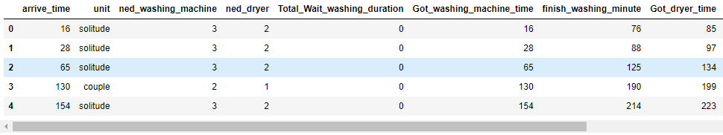
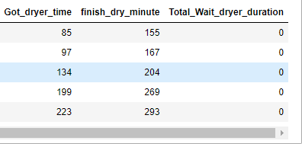
05
Output Dataframe

Slide 8
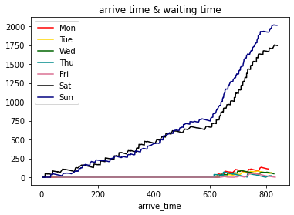
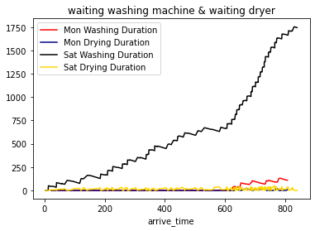
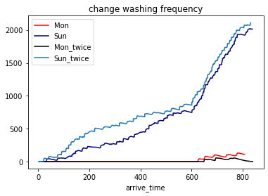
06
Visualization

Slide 9
07
Future Improvement
Run enough times to get credible data
1
2
Simplify the code to optimize time complexity
3
Add input variable -- the time to wait for the user to take out the clothes each time the washing machine or dryer finishes its work
4
Consider other factors to refine the model (e.g. holiday, fall break, weather)
5
Propose recommendations based on the results
(e.g. the ratio of dryers to washing machines,
need to upgrade the machine to shorten the waiting time?)

Slide 10
Thank you
Github: https://github.com/DYZhang117/2021Fall_finals

